Slide 1

Chittagong University of Engineering and Technology
Department of Electronics and Telecommunication Engineering
Smart Industrial Environment Monitoring &
Control System
ETE 416 : IoT and Industrial Automation Sessional
PRESENTED BY:
Fariha Tasnim Arpa (ID : 2008006)
Turja Talukder (ID : 2008022)
Nusrat Jahan (ID : 2008056)
SUPERVISED BY:
TAIEBA TAHER,
ASSISTANT PROFESSOR,
DEPT. OF ETE, CUET

Slide 2
CONTENTS
Introduction
Problem Statement
Proposed Solution
Project Objectives
System Components
Block Diagram
Circuit Diagram
Workflow Diagram
Results
Control Strategy
Security Considerations
Future Works
Conclusion
References

Slide 3
INTRODUCTION
Modern industries require continuous monitoring of environmental parameters.
Unsafe conditions can cause equipment damage, health hazards, production loss.
Manual monitoring is inefficient, costly and error-prone.
IoT enables real-time monitoring, automation and remote control.

Slide 4
PROBLEM STATEMENT
Lack of real-time industrial environment monitoring.
Delayed detection of gas leakage, high temperature & humidity, poor air quality.
No centralized control system.
Limited scalability and high cost of traditional industrial solutions.

Slide 5
PROPOSED SOLUTION
Continuous Monitoring
Temperature, humidity, gas leakage, air quality, and object avoidance.
Real-time Cloud Data
Instantaneous data transmission to the cloud for analysis and access.
Automated Actuator Control
Intelligent management of fans and bulbs based on conditions.
Secure Web Dashboard
Centralized platform for remote monitoring and control.

Slide 6
PROJECT OBJECTIVES
Main Objective
To design and implement a smart, secure, and scalable industrial environment monitoring and control system using IoT.
Specific Objectives
Real-time sensor data collection.
Cloud based data visualization.
Actuator management based on predefined rules.
Fundamental security measures integrated.
User-friendly, industrial-grade monitoring interface.

Slide 7
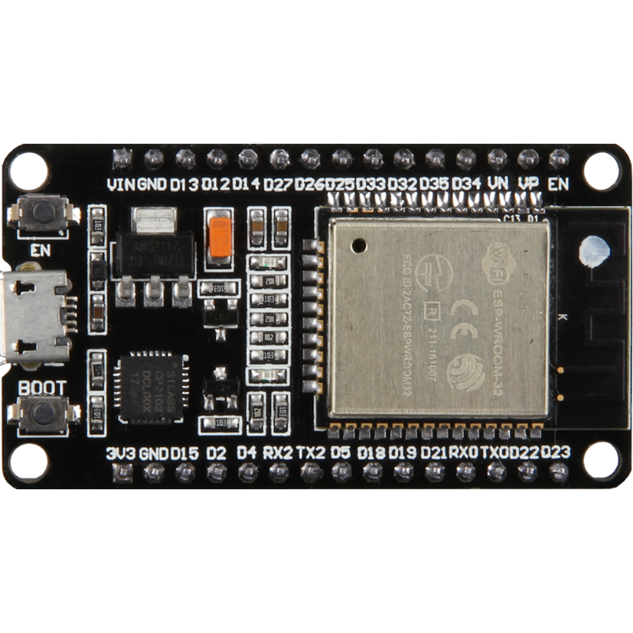
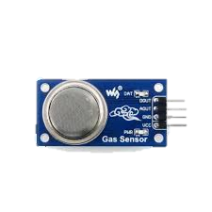
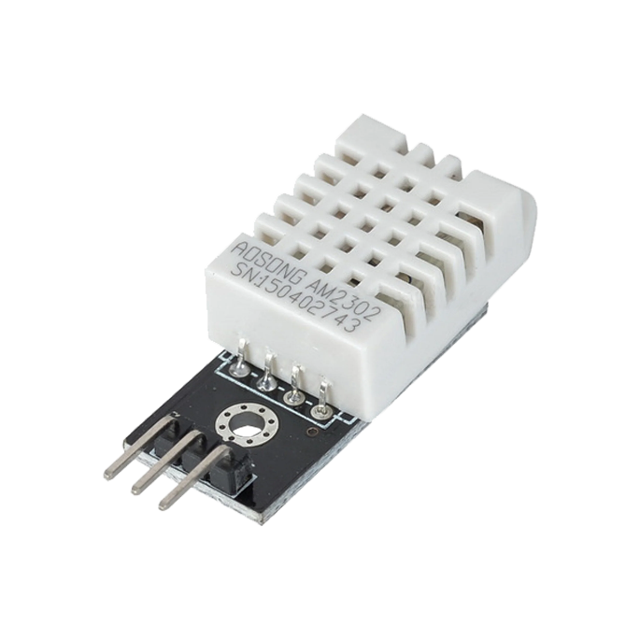
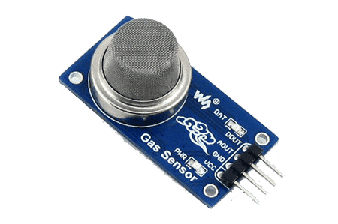
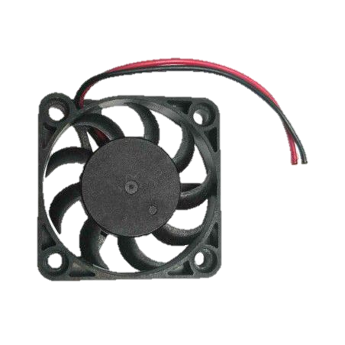
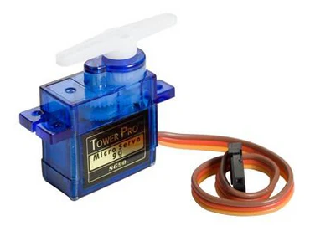
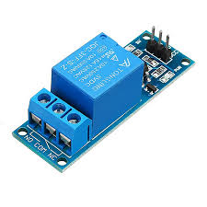
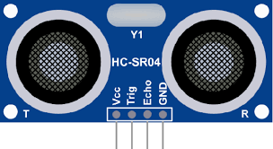
SYSTEM COMPONENTS
Hardware Essentials
(a) ESP 32 MCU
(b) DHT 22 sensor
(c) MQ2 Gas Sensor
(d) MQ135 Air quality sensor
(e) HC-SR04 SONAR
(f) Servomotor
(g) 1 Channel Relay
(h) Fan

Slide 8
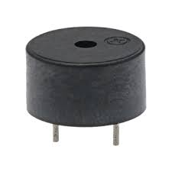
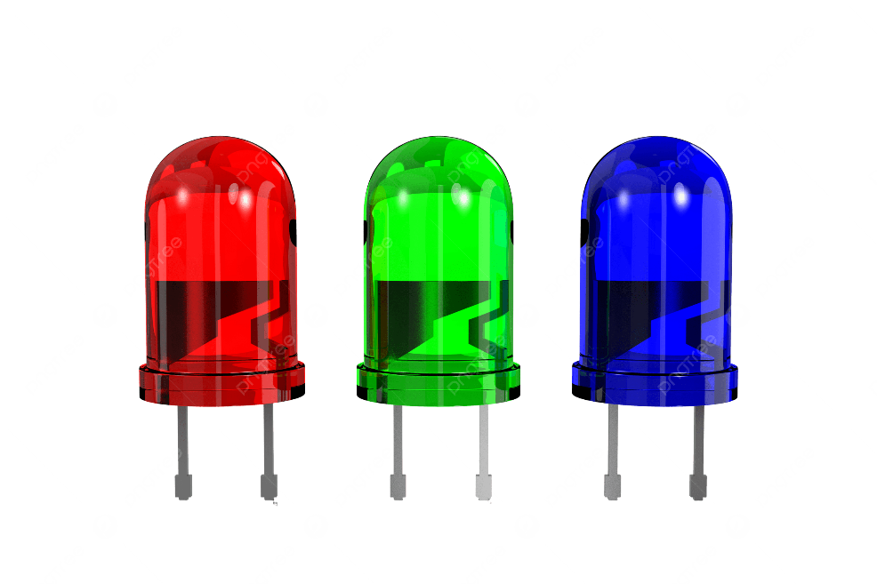
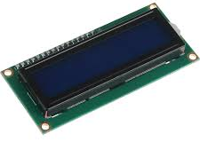
SYSTEM COMPONENTS
Hardware Essentials
(i) Buzzer
(j) LED
(k) 16×2 LCD Display

Slide 9
SYSTEM COMPONENTS
Software Ecosystems
Arduino IDE
MQTT protocol
Node-RED dashboard

Slide 10
BLOCK DIAGRAM
WiFi Connect
ESP-32
MCU
Buzzer
Object Detect/ Gas Alert
LED Indicator
Gas detected
DHT22
Temperature & Humidity Sensor
Relay
Fan
High Temperature detected
MQ2 Sensor
Smoke/Gas
Servo motor scanning
off when object is detected
MQ135 Sensor
Air Quality
16×2 LCD Display
displays all readings
Status
Safe/Danger/Critical
HC-SR04 with servomotor
Ultrasonic sensor
iotfrontier/live
Live JSON payload
User Interface
MQTT Broker
iotfrontier/history
Batch every 2 min
Figure 1: Block diagram of the project

Slide 11
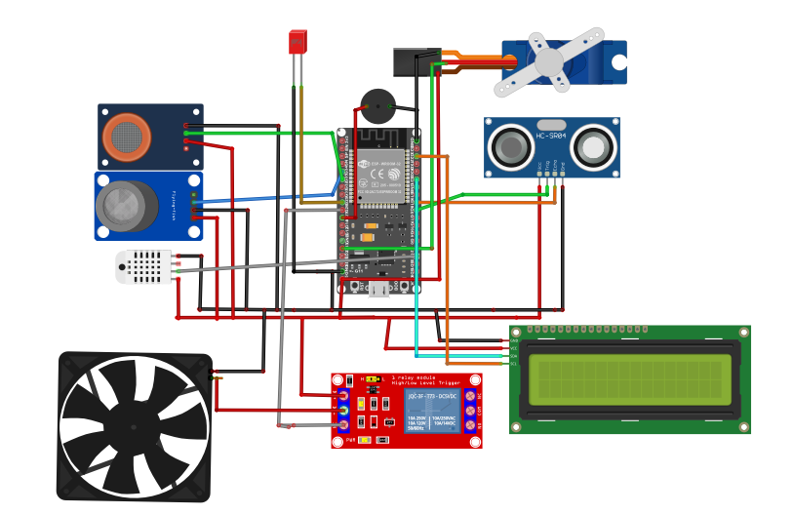
CIRCUIT DIAGRAM
Figure 2: Circuit diagram of the project

Slide 12
WORKFLOW DIAGRAM
System Power On
Initialize ESP32 sensors & WIFI
Read Sensor Data from DHT22, MQ2, MQ135 and SONAR
Convert Analog signals to Digital
Process Data using Threshold Logic
Values exceed safety limits? Or is there any object under 20 cm?
Continues Normal Operation
No
Yes
Activate Fan (based on temperature), LED and Buzzer (Gas alert), Buzzer and Servo motor off (obstacle alert)
Publish Data to IoT Cloud (MQTT JSON)
Show Live Data & Status on LCD
Display Data on Cloud Dashboard
Store Data in History Buffer
Figure 3: Workflow Diagram of the project

Slide 13
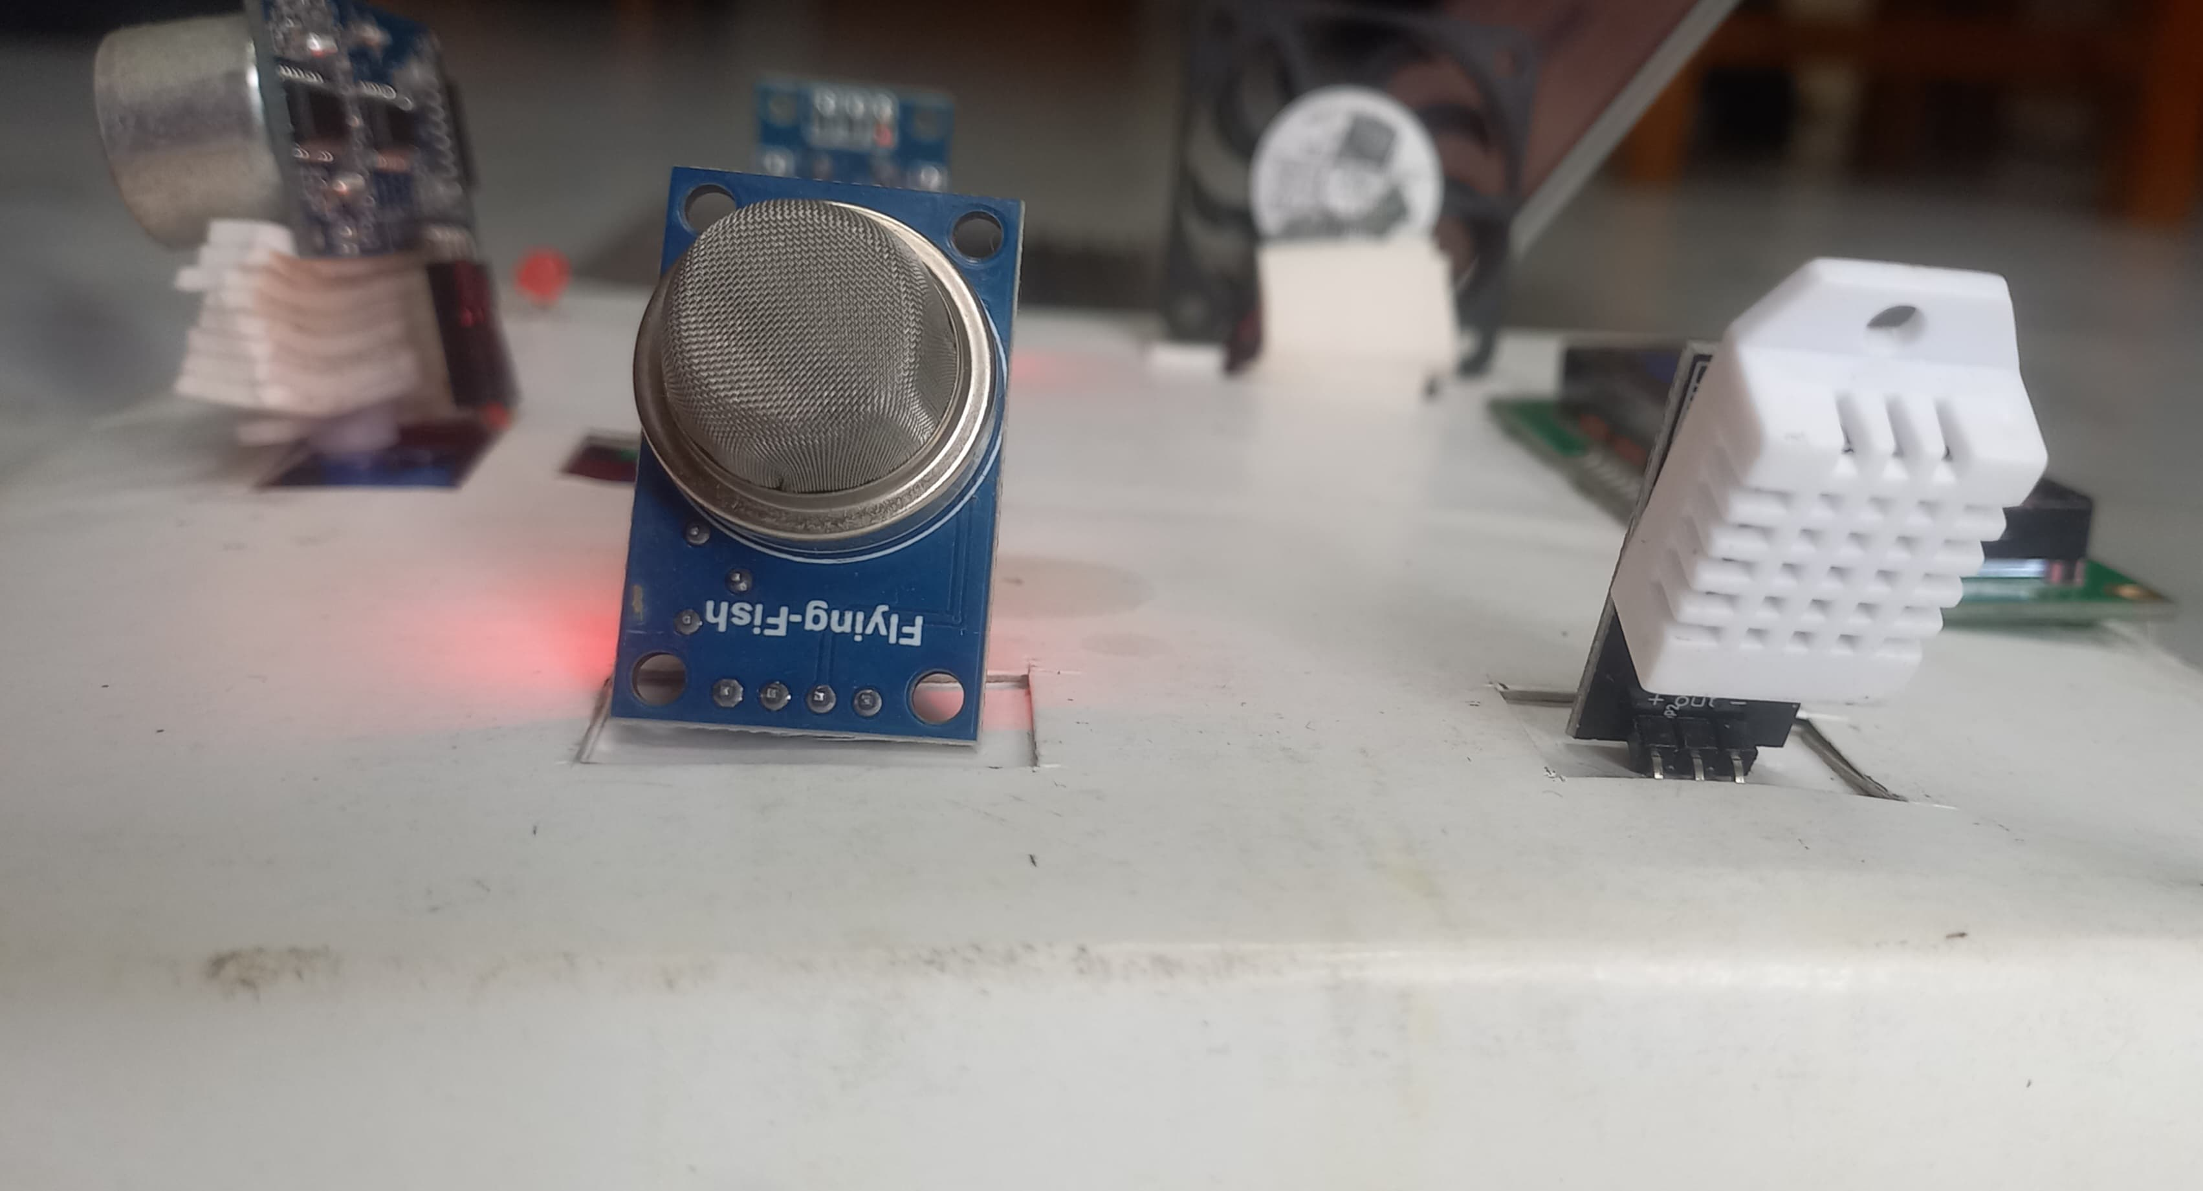
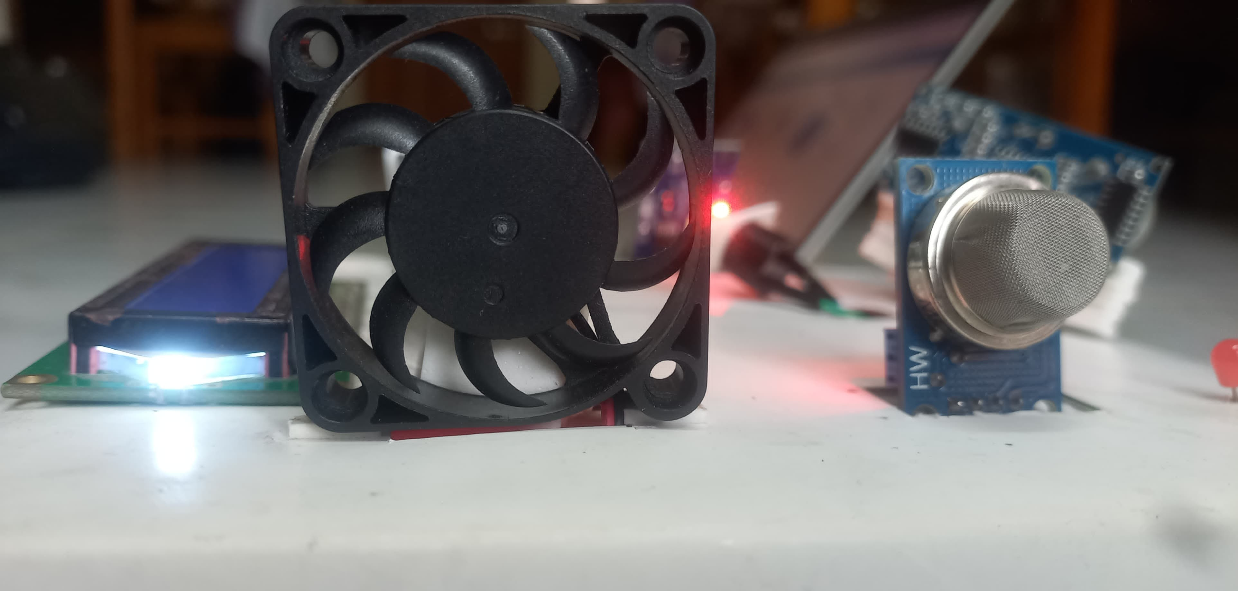
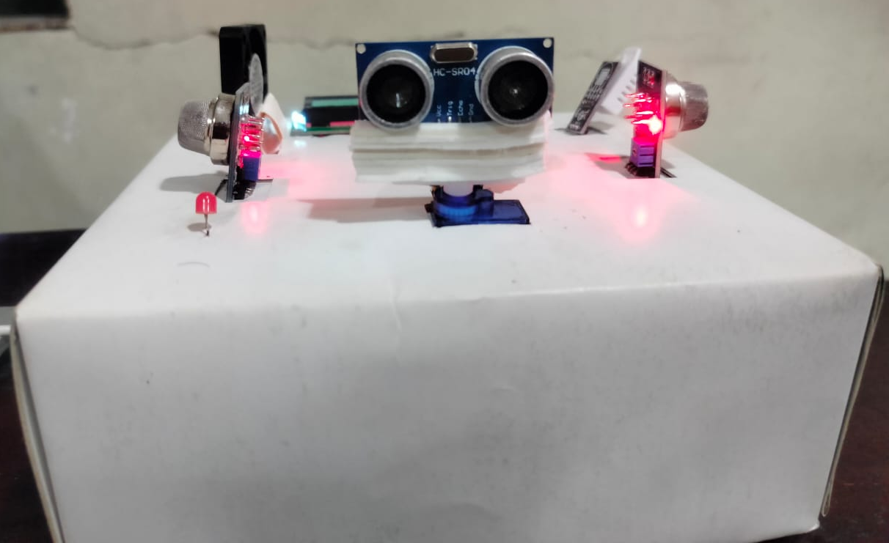
RESULTS
Figure 4: Hardware implementation of the sensor and actuator

Slide 14
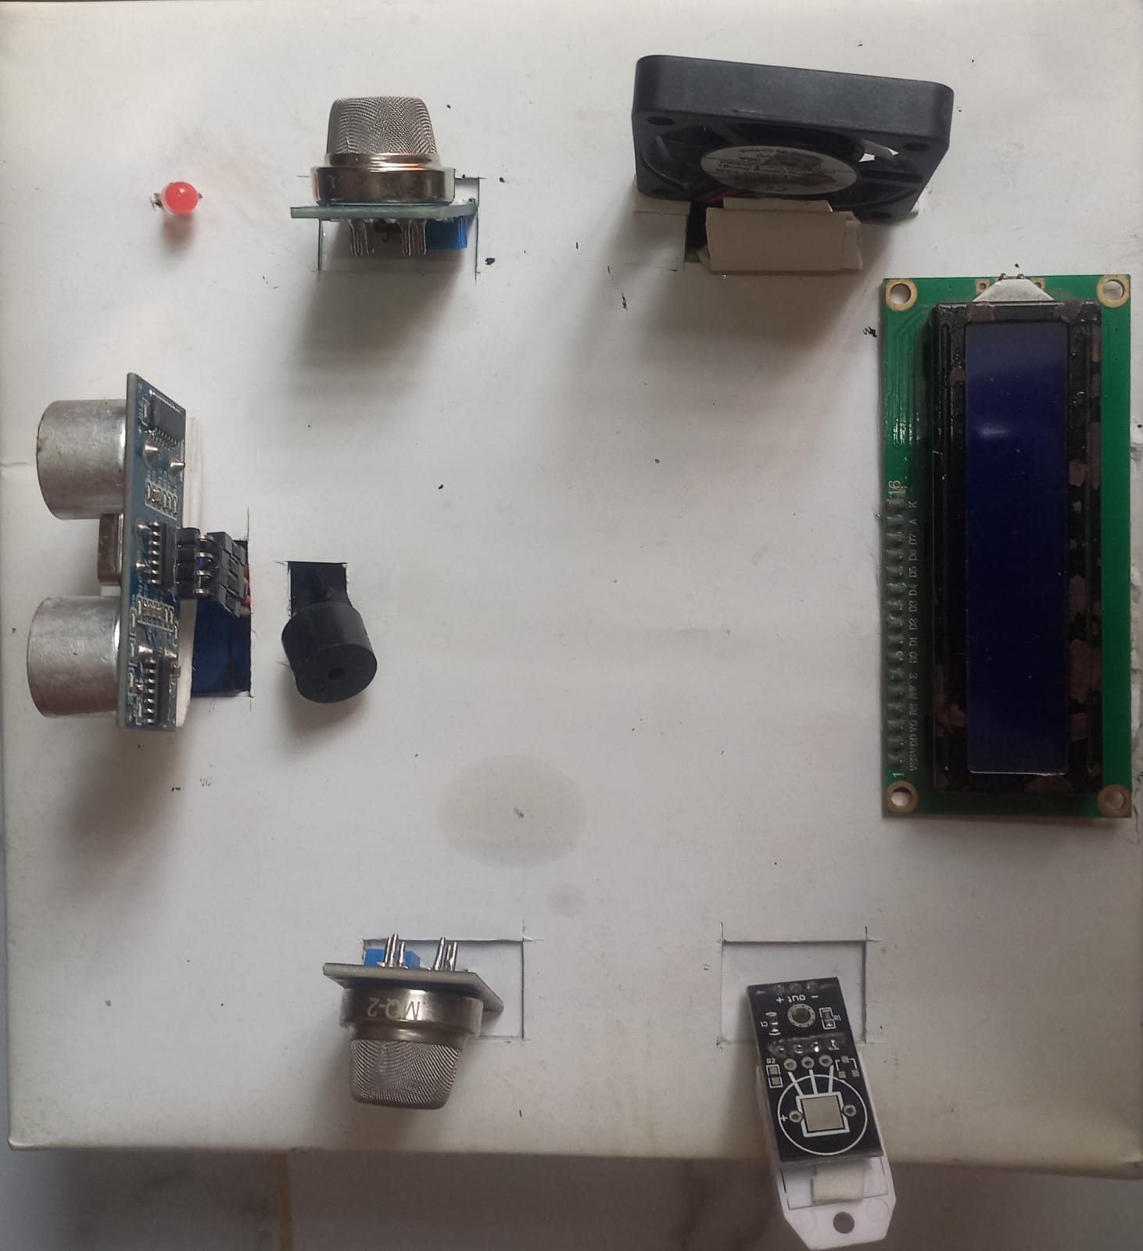
RESULTS
Figure 5: Hardware setup of Smart Industrial Environment Monitoring & Control System

Slide 15
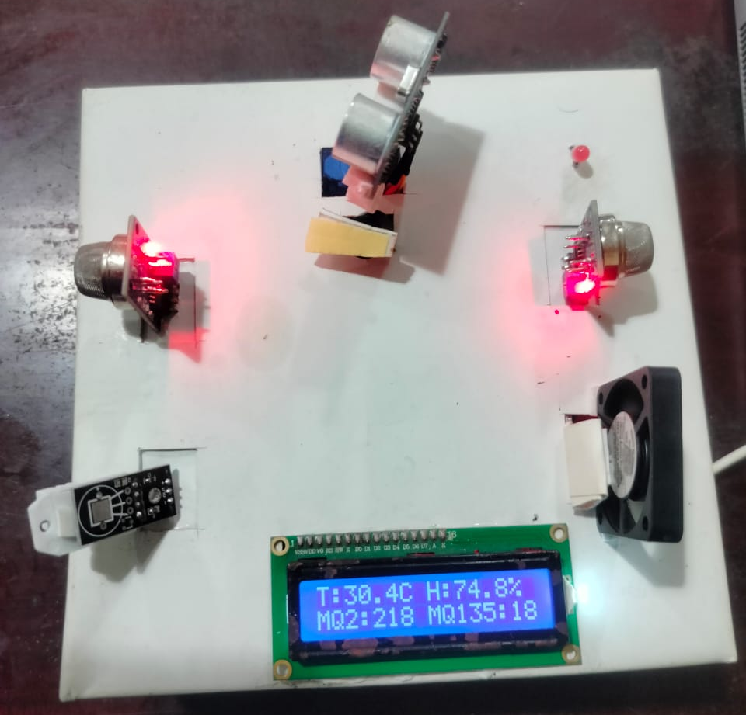
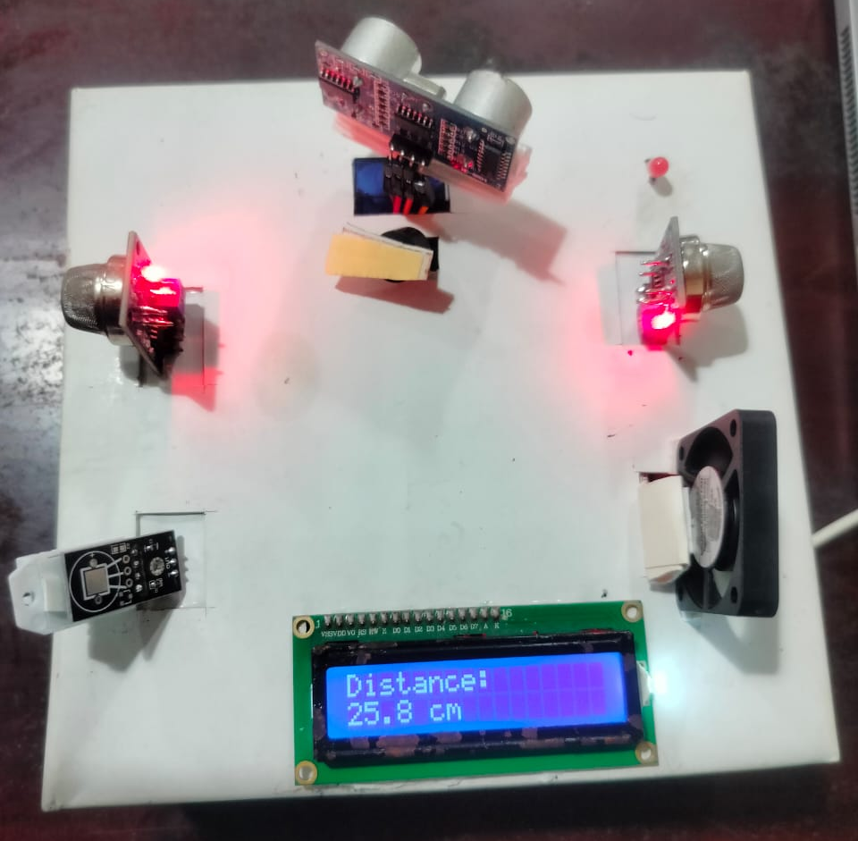
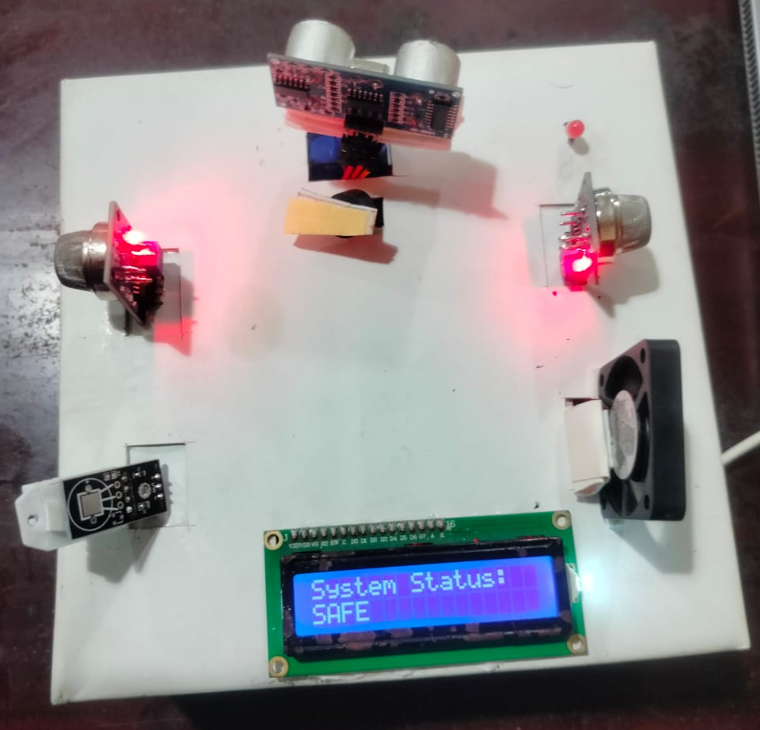
RESULTS
Figure 6: Hardware implementation of the project with LCD display results

Slide 16
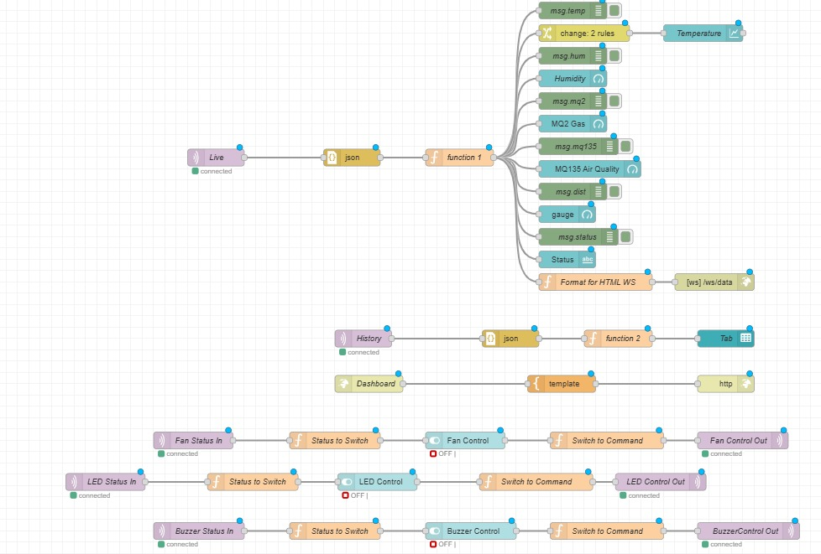
RESULTS
Figure 7: Figure of the Node-RED interface

Slide 17
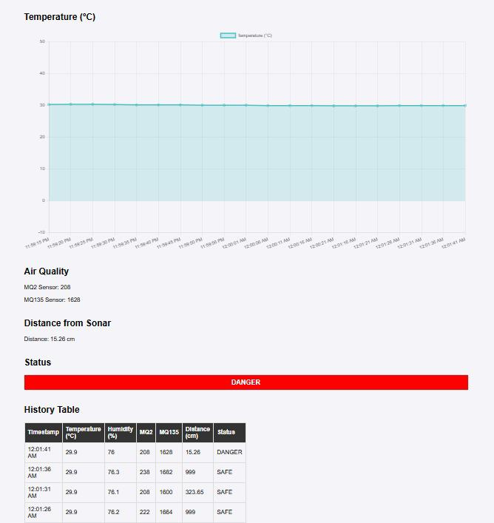
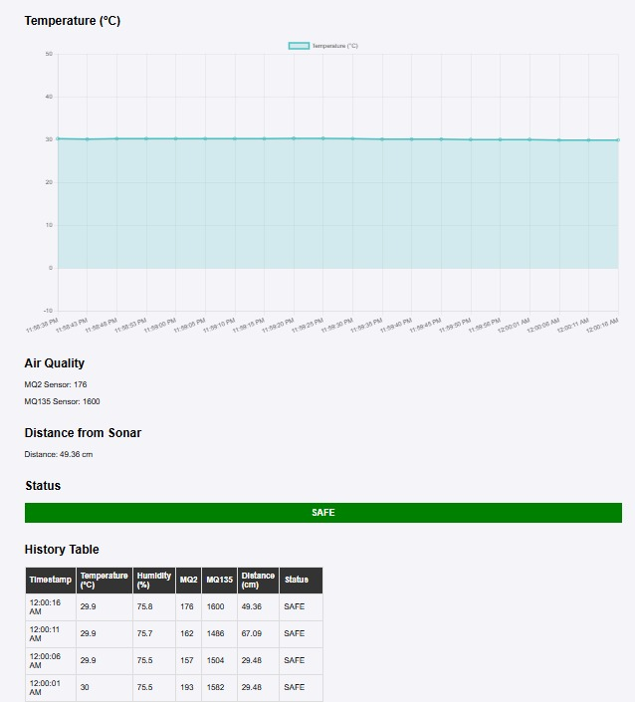
RESULTS
Figure 8: Web-Based Dashboard Showing Real-Time Environmental Monitoring and System Status (For user)

Slide 18
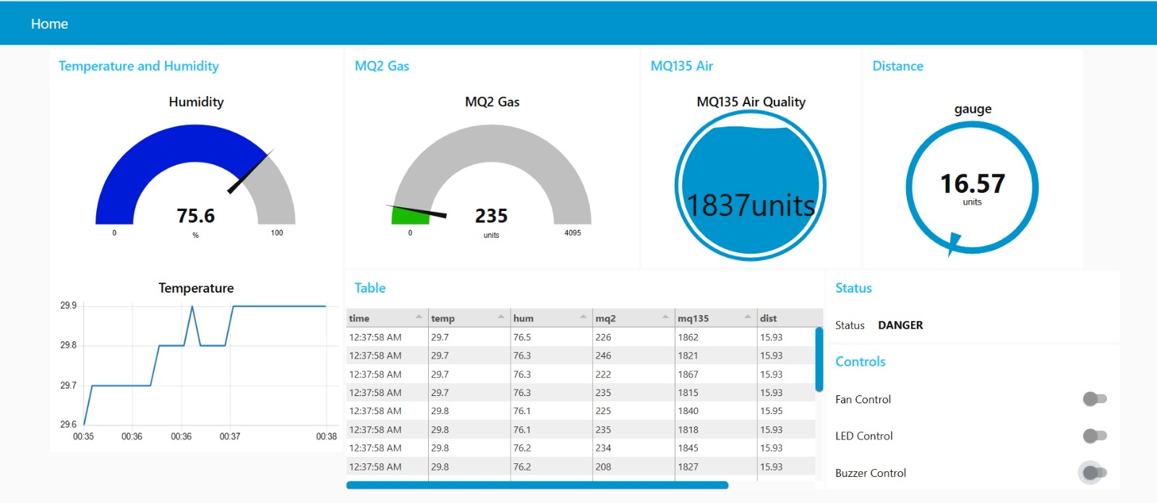
RESULTS
Figure 9: Web-Based Dashboard with controlling system (For admin)

Slide 19
CONTROL STRATEGY
Temperature, gas, air quality, and distance are monitored in real time using ESP32 and sensors.
Automatically controls the fan, buzzer, and LED when threshold values are exceeded.
SAFE or DANGER status is determined based on live sensor readings.
Dashboard switches allow both automatic synchronization and manual override control.
MQTT enables two-way communication between the ESP32 and the web dashboard.

Slide 20
SECURITY CONSIDERATIONS
Secure Wi-Fi communication between ESP32 and cloud.
API keys used for device authentication.
MQTT data transmission with access control.
Restricted dashboard access for authorized users only.
Basic protection against unauthorized data access.

Slide 21
FUTURE WORKS
Mobile application development.
AI-based predictive monitoring .
Enhanced security implementation.
Using flame sensor and OLED display.

Slide 22
CONCLUSION
Successfully demonstrated an IoT-based industrial monitoring and control system.
Sensors, embedded systems, and cloud-based visualization were integrated for real-time monitoring and automation.
Minor fluctuations were observed in the gas sensor readings during operation.
Network latency slightly affected the real-time visualization performance.
Servo-based scanning improved the detection coverage area.
The system reduced the need for continuous manual monitoring.

Slide 23
REFERENCES
IoT-Enabled Smart Industrial Pollution Monitoring & Control System Using RaspberryPi PICO with BLYNK by svsembedded. Link : https://www.youtube.com/watch?v=tipmL7c9bSo
Kadam Kranti A et al. (2018). “Smart Industry Based Environment Monitoring and Controlling System”.

Slide 24
THANK YOU
For your attention

